Slide 1

Placental Bioinformatics Course
Practical
Dr Russell S. Hamilton
Email: rsh46@cam.ac.uk
Twitter: @drrshamilton
Dr Xiaohui Zhao
Email: xz289@cam.ac.uk
Dr Malwina Prater
Email: mn367@cam.ac.uk
Course Materials:
https://github.com/CTR-BFX/2019-PlacentalBiologyCourse
License: Attribution-Non Commercial-Share Alike CC BY-NC-SA ( https://creativecommons.org/licenses/by-nc-sa/ )
Attribution: You must give appropriate credit, provide a link to the license, and indicate if changes were made.
You may do so in any reasonable manner, but not in any way that suggests the licensor endorses you or your use.
NonCommercial: You may not use the material for commercial purposes.
ShareAlike: If you remix, transform, or build upon the material, you must distribute your contributions under the same license as the original.
Version 0.1: 20190619

Slide 2
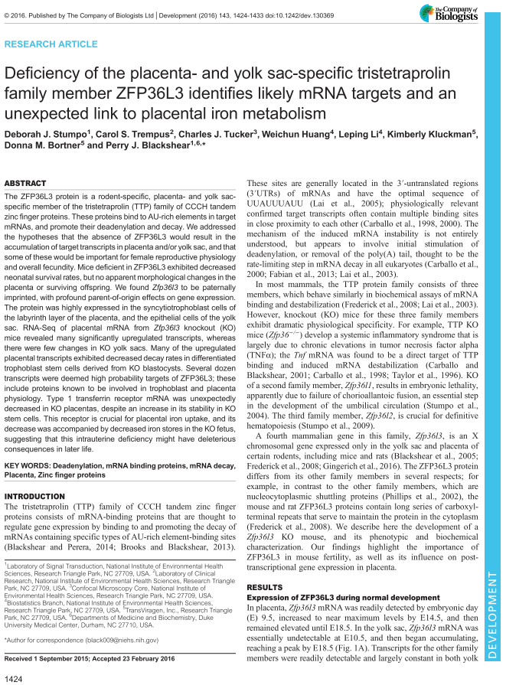
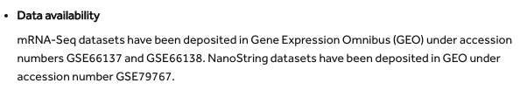
Data Introduction
RNA-Seq Differential Gene expression
between the Placenta and Yolk Sac Mouse
Bioinformatics Top Tip:
Download fastq files directly from
http://www.ebi.ac.uk/ena
Warning:
This is a demo with a reduced data set and parameters,
so take any genes identified with caution
Russell S. Hamilton (rsh46@cam.ac.uk), Xiaohui Zhao (xz289@cam.ac.uk) & Malwina Prater (mn367@cam.ac.uk) 2

Slide 3
Introduction
sample | condition
SRR1811706 | WT Yolk Sac
SRR1811707 | WT Yolk Sac
SRR1811708 | WT Yolk Sac
SRR1811709 | WT Yolk Sac
SRR1823638 | WT Placenta
SRR1823639 | WT Placenta
SRR1823640 | WT Placenta
SRR1823641 | WT Placenta
SRR1823642 | WT Placenta
SRR1823643 | WT Placenta
SRR1823644 | WT Placenta
4x YolkSac
Differentially Expressed Genes / Transcripts
7x Placenta
Russell S. Hamilton (rsh46@cam.ac.uk), Xiaohui Zhao (xz289@cam.ac.uk) & Malwina Prater (mn367@cam.ac.uk) 3

Slide 4
Bioinformatics Pipeline
Sequencing Files (FASTQ) FastQC
Perform quality control (adapter contamination, base quality) trim_galore
Command Line
Align reads to the genome/transcriptome kallisto
Summarise QC and alignment metrics MultiQC
Perform differential gene/transcript expression analysis DESeq2
R/R-Studio
Perform Gene Ontology analysis clusterProfiler
(R/R-Studio, system call)
Break
Lecture 2
Russell S. Hamilton (rsh46@cam.ac.uk), Xiaohui Zhao (xz289@cam.ac.uk) & Malwina Prater (mn367@cam.ac.uk) 4
Notes:
Remove sleuth.

Slide 5
Using the Bioinformatics Training Facility Computers
R-Studio
Terminal
Russell S. Hamilton (rsh46@cam.ac.uk), Xiaohui Zhao (xz289@cam.ac.uk) & Malwina Prater (mn367@cam.ac.uk) 5

Slide 6
Files Summary
2019_PlacentalBiologyCourse_Lecture_1.pptx
2019_PlacentalBiologyCourse_Practical_1.pptx
2019_PlacentalBiologyCourse_Commands_Rversion.Rmd
2019 _PlacentalBiologyCourse_Lecture_2.pptx
2019_PlacentalBiologyCourse_DESeq2.Rmd
stumpo_2016_Development.pdf
SRR1811706_ES610_WT_Yolk_Sac/
SRR1811707_ES611_WT_Yolk_Sac/
SRR1811708_ES612_WT_Yolk_Sac/
SRR1811709_ES613_WT_Yolk_Sac/
SRR1823638_ES51_WT_Placenta/
SRR1823639_ES51_WT_Placenta/
SRR1823640_ES52_WT_Placenta/
SRR1823641_ES52_WT_Placenta/
SRR1823642_ES53_WT_Placenta/
SRR1823643_ES54_WT_Placenta/
SRR1823644_ES55_WT_Placenta/
ENST_ENSG_GeneName.GRCm38.kallisto.table
Mus_musculus.GRCm38.cdna.all.idx
SRR1823638_sub_1.fastq.gz
SRR1823638_sub_2.fastq.gz
Course Materials
SRR1823638 Sequencing Data
SRR1823638_1.fastq.gz_trimming_report.txt
SRR1823638_1_fastqc.html
SRR1823638_1_fastqc.zip
SRR1823638_1_val_1.fq.gz_kallisto_output/
SRR1823638_1_val_1_fastqc.html
SRR1823638_1_val_1_fastqc.zip
SRR1823638_2.fastq.gz_trimming_report.txt
SRR1823638_2_fastqc.html
SRR1823638_2_fastqc.zip
SRR1823638_2_val_2_fastqc.html
SRR1823638_2_val_2_fastqc.zip
Kallisto Output
Publication
abundance.h5
abundance.tsv
run_info.json
Sample Data
Reference Genome
Practical Data Sets
Subset of real data for this practical 1M reads only (~10%)
Russell S. Hamilton (rsh46@cam.ac.uk), Xiaohui Zhao (xz289@cam.ac.uk) & Malwina Prater (mn367@cam.ac.uk) 6
Notes:
Format as a list and change 2018 to 2019, reducing the reads from 1M from last year to 0.5M, all steps run for fastqc to kallisto finished just use at most 3mins. I save them in /PlacentaCourse/SRR1823638_sub_2019 folder, plus a version of command line file for 2019 by adding a few unix commands as indicated in ppt next slide.

Slide 7
FastQC
FastQC A quality control tool for high throughput sequence data
Version 0.11.5
Download http://www.bioinformatics.babraham.ac.uk/projects/fastqc/
Terminal:
$ fastqc SRR1823638_sub_1.fastq.gz SRR1823638_sub_2.fastq.gz
Output: (Link: http://ctr-web.pdn.cam.ac.uk/SRR1823638_sub_1_fastqc.html)
HTML Reports Archive of data/images
SRR1823638_sub_1_fastqc.html SRR1823638_sub_1_fastqc.zip
SRR1823638_sub_2_fastqc.html SRR1823638_sub_2_fastqc.zip
Read 1
Read 2
Bioinformatics Top Tip: Simon Andrews’ https://sequencing.qcfail.com/
Russell S. Hamilton (rsh46@cam.ac.uk), Xiaohui Zhao (xz289@cam.ac.uk) & Malwina Prater (mn367@cam.ac.uk) 7

Slide 8
trim_galore
trim_galore A wrapper tool around Cutadapt to consistently apply quality and adapter trimming to FastQ files
Version 0.6.3
Download http://www.bioinformatics.babraham.ac.uk/projects/trim_galore/
Terminal:
$ trim_galore --paired --gzip -q 20 SRR1823638_sub_1.fastq.gz SRR1823638_sub_2.fastq.gz
Output:
Trimmed Fastq files
SRR1823638_sub_1_val_1.fq.gz
SRR1823638_sub_2_val_2.fq.gz
Compress the output fastq files
Read 1
Read 2
Treat as paired-end
Quality score threshold (PHRED > 20), default
Russell S. Hamilton (rsh46@cam.ac.uk), Xiaohui Zhao (xz289@cam.ac.uk) & Malwina Prater (mn367@cam.ac.uk) 8

Slide 9
kallisto
kallisto Program for quantifying abundances of transcripts from RNA-Seq data, without the need for alignment
Version 0.44.0
Download https://pachterlab.github.io/kallisto
Terminal:
$ kallisto quant -b 25 -i Mus_musculus.GRCm38.cdna.all.idx
-o kallisto_output SRR1823638_sub_1_val_1.fq.gz SRR1823638_sub_2_val_2.fq.gz
Output:
kallisto_output/
abundance.h5
abundance.tsv
run_info.json
Number of bootstraps
Indexed transcriptome
Output directory
Trimmed Read 1
Trimmed Read 2
Note command must be all on one single line
Russell S. Hamilton (rsh46@cam.ac.uk), Xiaohui Zhao (xz289@cam.ac.uk) & Malwina Prater (mn367@cam.ac.uk) 9

Slide 10
RNA-Seq Mapping Metrics: Counts Vs FPKM Vs TPM
Counts
The number of reads mapping to a transcript or gene
Longer transcripts will generally have more mapped reads
FPKM (Fragments Per Kilobase of transcript per Million mapped reads)
Normalises the counts for the length of the transcript
TPM (Transcripts Per Million)
Measurement of the proportion of transcripts in your pool of RNA
None of these are for comparing across samples
Sample normalisation required as performed by DESeq2
Kallisto output with counts and TPM
Russell S. Hamilton (rsh46@cam.ac.uk), Xiaohui Zhao (xz289@cam.ac.uk) & Malwina Prater (mn367@cam.ac.uk) 10

Slide 11
MultiQC
MultiQC Aggregate results from bioinformatics analyses across many samples into a single report
Version 1.1dev
Download http://multiqc.info/
Terminal:
$ multiqc -f -i "Placental Biology Course 2018"
--filename ”PlacentalBiologyCourse.multiqc_report.html" .
Output: (link: http://ctr-web.pdn.cam.ac.uk/multiqc.html)
HTML Report
PlacentalBiologyCourse.multiqc_report.html
PlacentalBiologyCourse.multiqc_report_data
Overwrite existing report
A title for your report
Output filename
“.” Is a special Linux symbol which means the current directory
Russell S. Hamilton (rsh46@cam.ac.uk), Xiaohui Zhao (xz289@cam.ac.uk) & Malwina Prater (mn367@cam.ac.uk) 11

Slide 12
Experimental Design

Slide 13
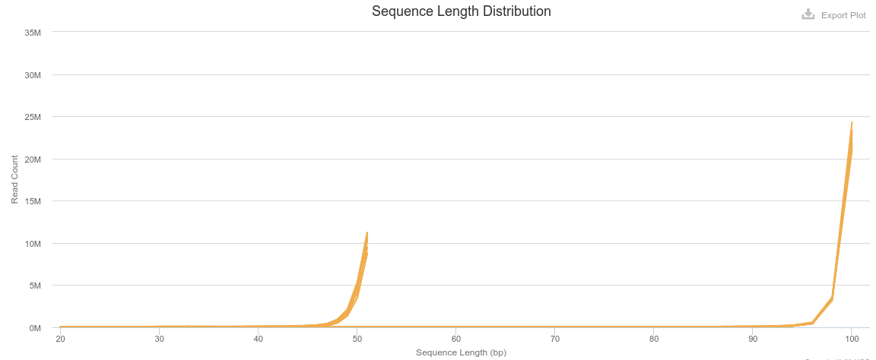
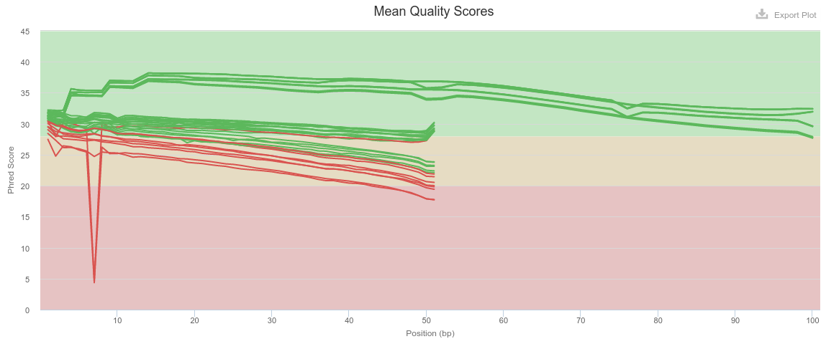
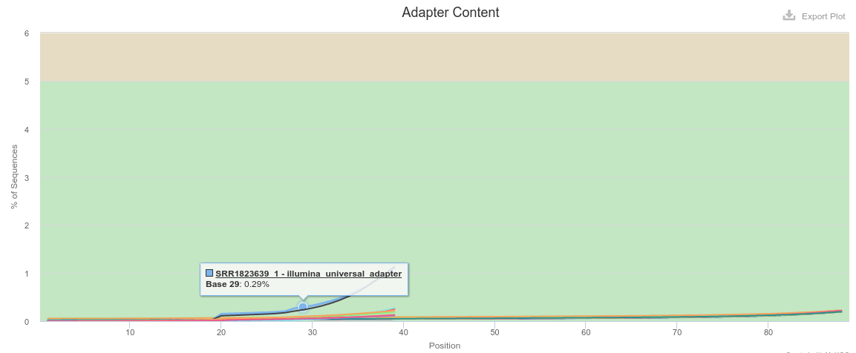
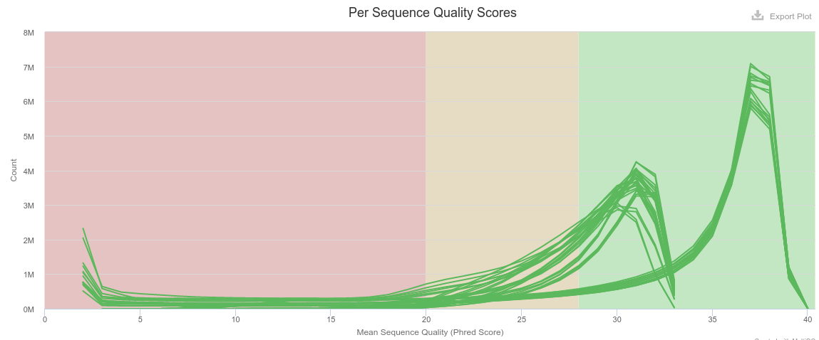
QC Fastq Files---- Batch Effects
Sample groups have different read lengths
Some Placenta samples have low quality scores
Yolk sac
Placenta
There are adapters in both sample groups
Placenta
Yolk sac
Russell S. Hamilton (rsh46@cam.ac.uk), Xiaohui Zhao (xz289@cam.ac.uk) & Malwina Prater (mn367@cam.ac.uk) 13

Slide 14
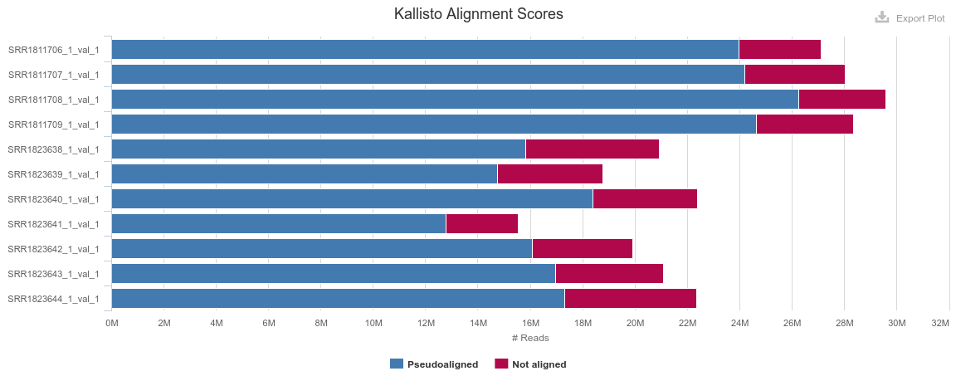
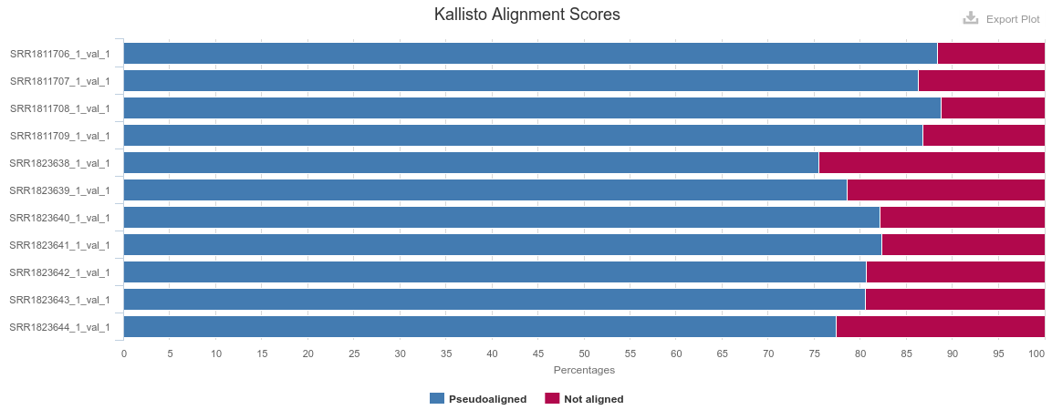
QC Alignments
Yolk Sac
Why do you never see 100% alignment?
Incomplete reference genomes / transcriptomes
Repetitive reads hard to map uniquely
Sample: Structural Variants
Copy Number Variants
Placenta
Yolk Sac
Harsher trimming, more reads removed / trimmed
Placenta
Russell S. Hamilton (rsh46@cam.ac.uk), Xiaohui Zhao (xz289@cam.ac.uk) & Malwina Prater (mn367@cam.ac.uk) 14

Slide 15
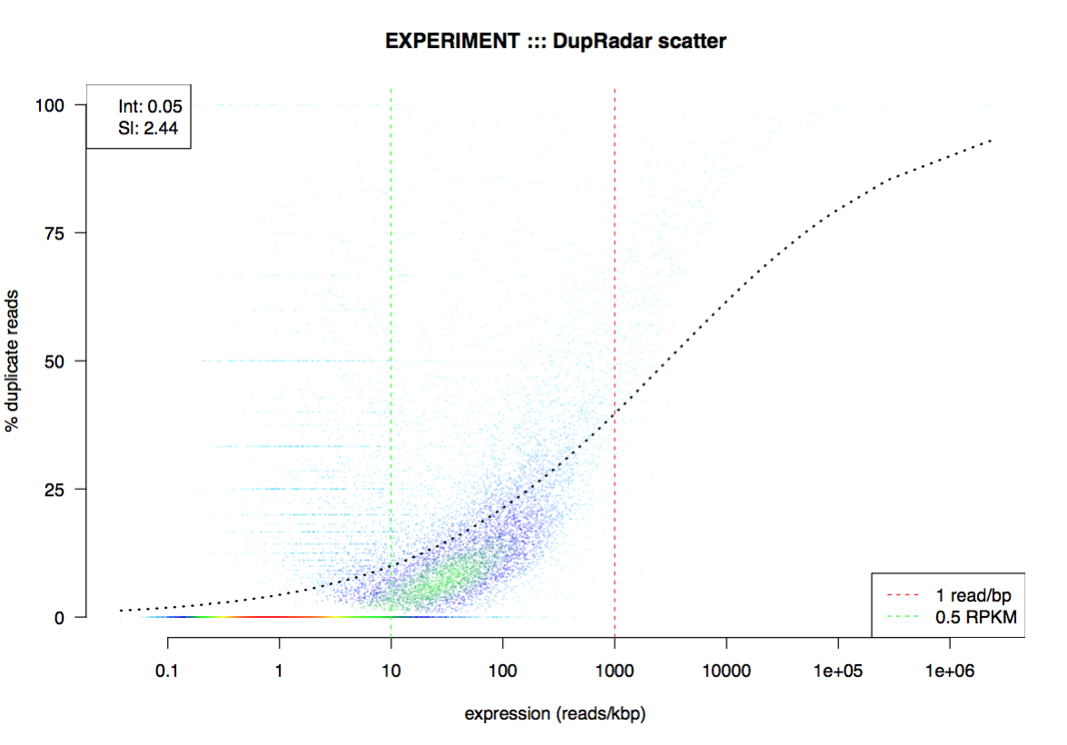
Further QC
rRNA and mt content
dupRadar
Batch effect correction
e.g. Two sequencing experiments performed on different days by two different people
Batch effect removal: Limma / Combat
Use batch in comparison in DESeq2 design
~ batch + condition
Custom plots
Russell S. Hamilton (rsh46@cam.ac.uk), Xiaohui Zhao (xz289@cam.ac.uk) & Malwina Prater (mn367@cam.ac.uk) 15

Slide 16
What is the next?
Break
Lecture 2
Practical 2
Russell S. Hamilton (rsh46@cam.ac.uk), Xiaohui Zhao (xz289@cam.ac.uk) & Malwina Prater (mn367@cam.ac.uk) 16

